Slide 1

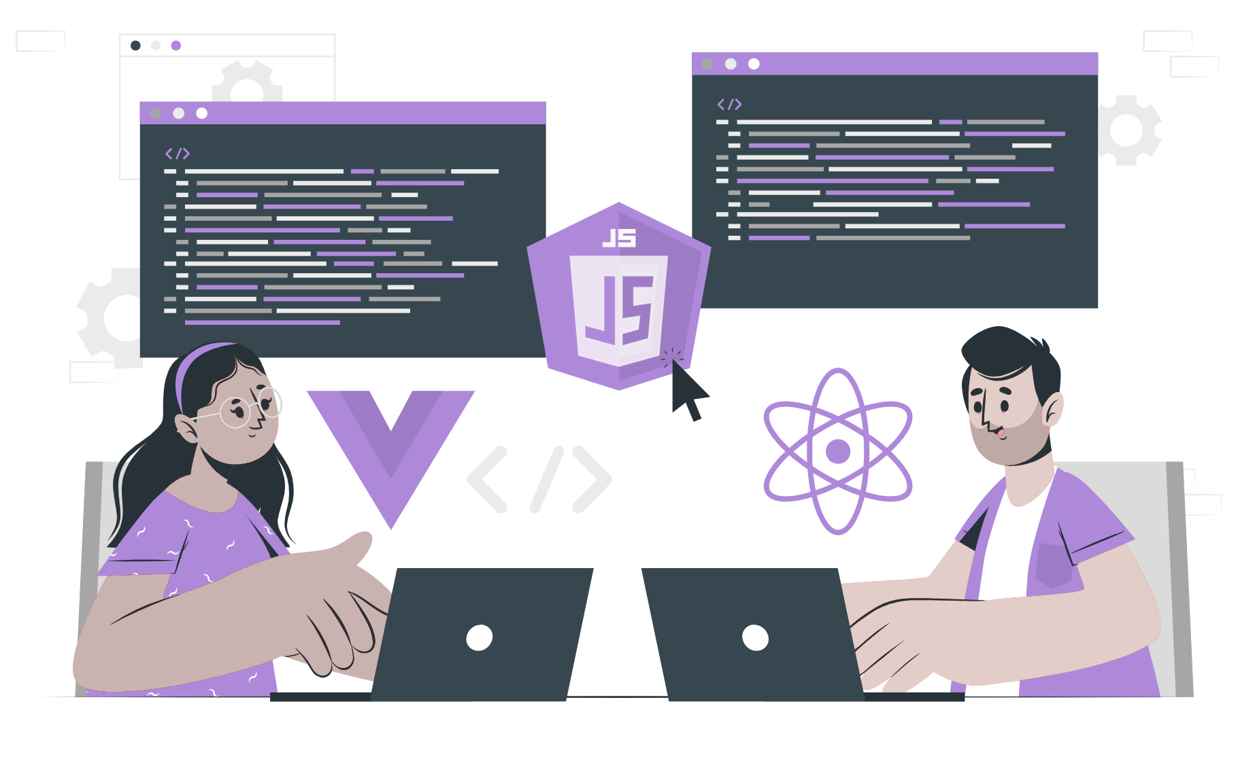
Writing first Hello World using Express.js

Slide 2
Topics
Environmental setup
Hello World

Slide 3
Environmental setup
Make sure Node.js installed in the system
node -v
//output - v18.12.0
Create a new directory and navigate inside the directory.
mkdir hello_world
cd hello_world
Initial new Nodejs project and install express
npm init -y
npm install express

Slide 4
Hello World
Create app.js in the root folder and the following code.
const express = require('express') // import express
const app = express() // create instance of express
const port = 3000 // define port
app.get('/', (req, res) => { // create a route with response “hello world!”
res.send('Hello World!')
})
app.listen(port, () => { // starts the server and listen for incoming request.
console.log(`Server up and listening on port ${port}`)
})
// output -
Server up and listening on port 3000

Slide 5
Continue …
To run the express application by running the following command:
node app.js
This command will start the server and will listen for incoming requests on the specified port. On visiting http://localhost:3000 the client will get a response of “Hello World!”.

Slide 6
THANK YOU

